Slide 1
Processing speed and multitasking in counter-strike players: a drift-diffusion model approach
Eleanor R. A. Hyde
PhD Student
11/01/2024

Slide 2



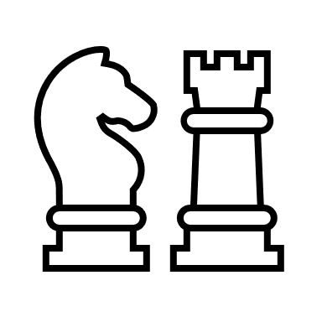
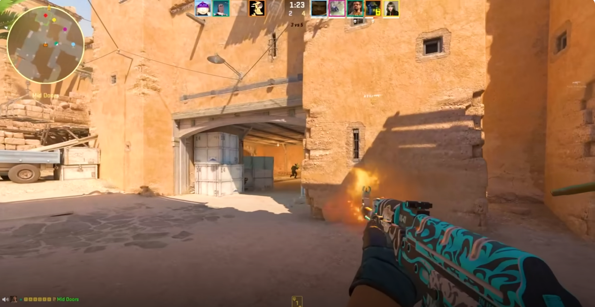
How can we enhance cognition?
Notes:
Alternative to cognitive training is engagement in cognitively stimulating leisure activities.
Video games are a very popular leisure activity, and First Person Shooter games in particular feature complex and dynamic environments, that require players to make fast decision-making.
My overarching research question is can playing FPS games enhance cognition?

Slide 3


Can video games benefit cognition?
Sala et al. (2018)
Bediou et al. (2018; 2023)
Smith & Basak (2023)
Notes:
Meta analytic findings are mixed
Sala found small to null effects of video game play (shooting/racing) on cognition.
Bediou found large effects of FPS play for a rang of cognitive domains such as perception and multitasking.
Smith & Basak found large effects of video game play on cognition.
But perhaps these mixed findings are due to some methodological limitations of the included studies.

Slide 4
Possible explanations
Broad definitions of video games
Small samples of relatively novice players
Short video gaming period (5 to 50 hours)
Limited assessment of video game skill and expertise

Slide 5
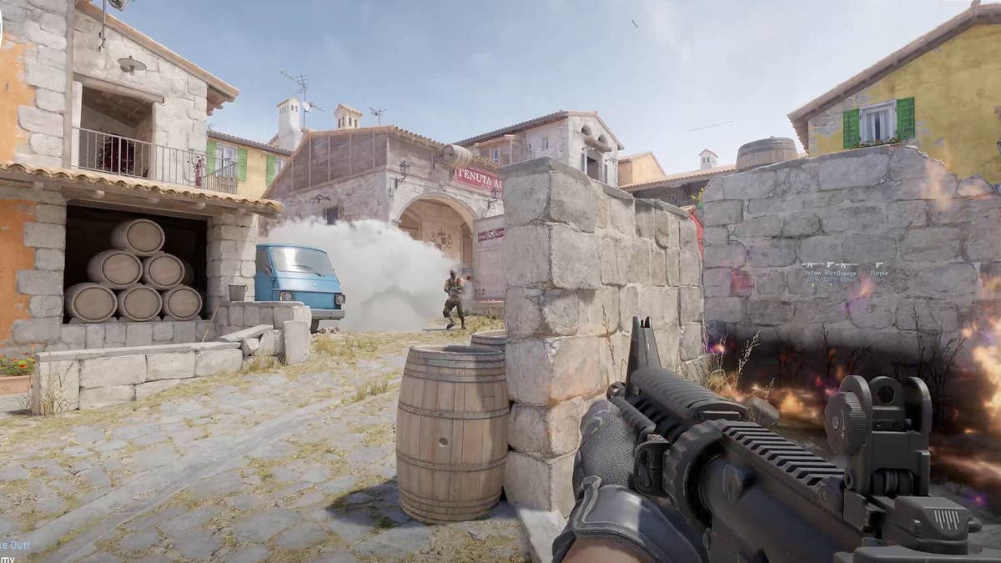

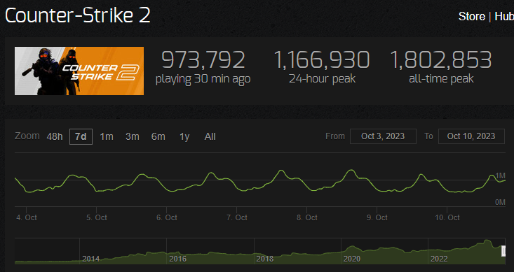
Counter-Strike
Notes:
One FPS game: CS. Super specific with our definition.
CS: highly popular FPS game played on PC only, CS:GO has been around for a long time and there’s the new version CS2 came out very recently. Theres a massive player base at the moment.
Played at the Professional eSports level – able to assess people with the most experience and training in the game.
Sheffield we have Endpoint No.1 UK CS team, No. 50 in EU –through existing connections we’re able to include these players in our research

Slide 6
Previous Literature
Supporting
Dye et al. (2009)
Colzato et al. (2010)
Cain et al. (2012)
Green et al. (2012)
Strobach et al. (2012b)
Chiappe et al. (2013)
Against
Karl et al. (2010)
van Ravenzwaaij et al. (2014)
Notes:
Literature unclear as to a benefit of video game play on processing speed and multitasking performance

Slide 7
Research Questions
How should we measure FPS expertise?
Is there a relationship between FPS expertise and cognitive performance: processing speed and multitasking.

Slide 8
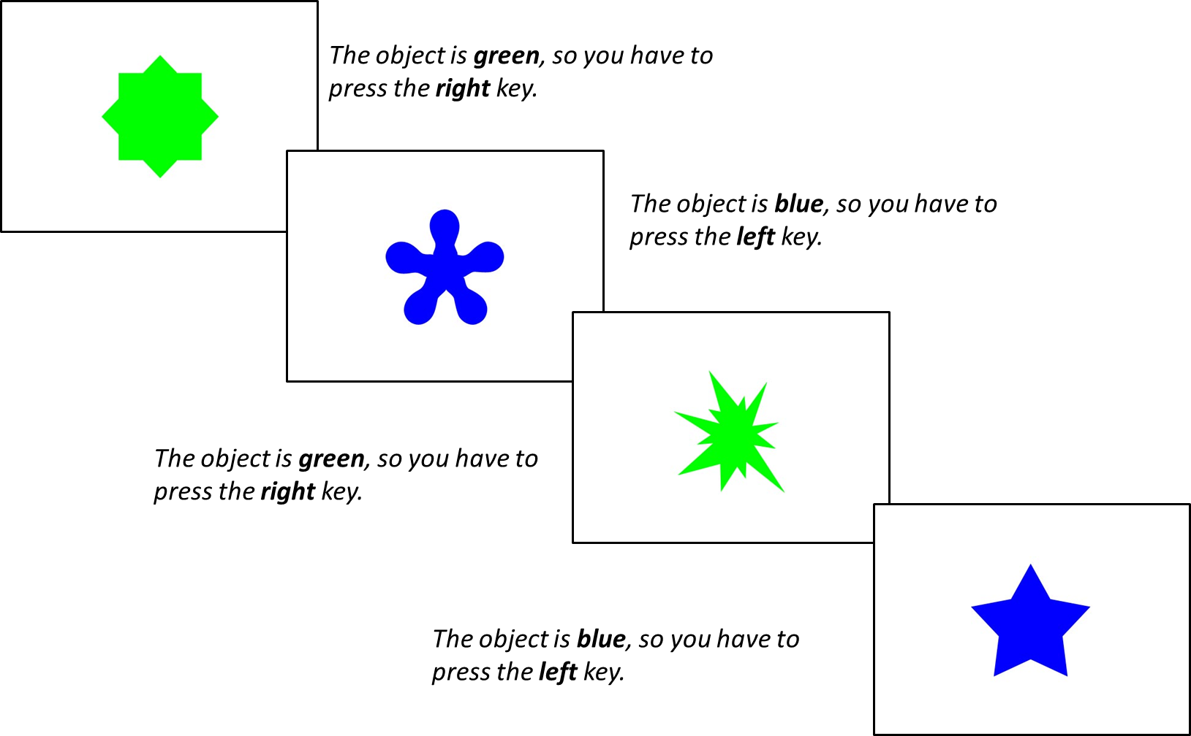
Method
Choice Reaction Time Task
Three Blocks:
Single-rule 1: 64 trials of shape followed by 64 trials of colour
Mixed-rule: 129 trials switching between shape and colour rule
Single-rule 2: 64 trials of colour followed by 64 trials of shape
n = 385
Within the Mixed-Rule Block:
Repetition trials: two successive trials in which the same rule is applied (shape + shape)
Switch trials: rule changed from the preceding trial to the current trial (shape + colour)
Notes:
Processing Speed: general ability to process information -> Reaction Times (RTs) and Accuracy Scores.
Ability to conduct two or more tasks at the same time -> Mixing and Switching Costs

Slide 9

Method
Choice Reaction Time Task
Pro
Expert
Casual
CS Questionnaire
Total hours playtime
Weekly hours playtime
Current Ranking (Standard MM)
Self-rated expertise
Notes:
Questionnaire informed by CS players who we interviewed ahead of this study

Slide 10
Participants (N = 235)
Sample Characteristics | n | % | M | SD
Gender
Males | 211 | 90
Females | 21 | 9
Non-Binary/Other | 3 | 1
Age |  |  | 21.93 | 4.69
Notes:
Recruited via CS Discord servers and word-of mouth
Male dominated, but not totally unexpcted, but it was super nice to see 10% of our CS players were other genders

Slide 11
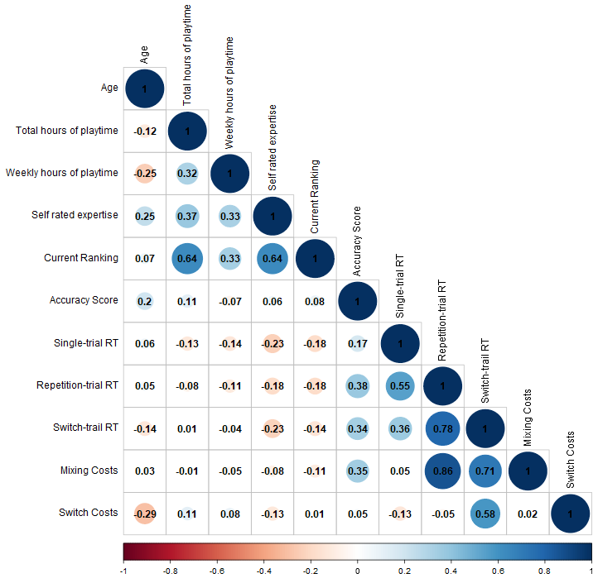
Zero-Order Correlations
Corrplot function from the Corrrplot package in R
Notes:
First thing we looked at was our CS expertise variables, total hours playtime, weekly hours playtime, self-rated expertise and current ranking. Many of these have been used in previous studies but not together.
Plot shows strong positive correlations (in blue) between our four expertise variables – nicely showing that these variables go hand in hand with each other.
Below, we have the correlations between our expertise variables and our cognitive variables. Negative correlations between our single-trial RTs and all four expertise measures, so greater expertise was associated with faster reaction times, but the significance drops off for repetition and switch RTs, mixing and switching costs. Some effect here but it looks to be limited.
But, this kind of analysis looked at the relationships between one expertise variable and one cognitive variable - perhaps a better reflection of CS expertise is the combination of these four variables.

Slide 12
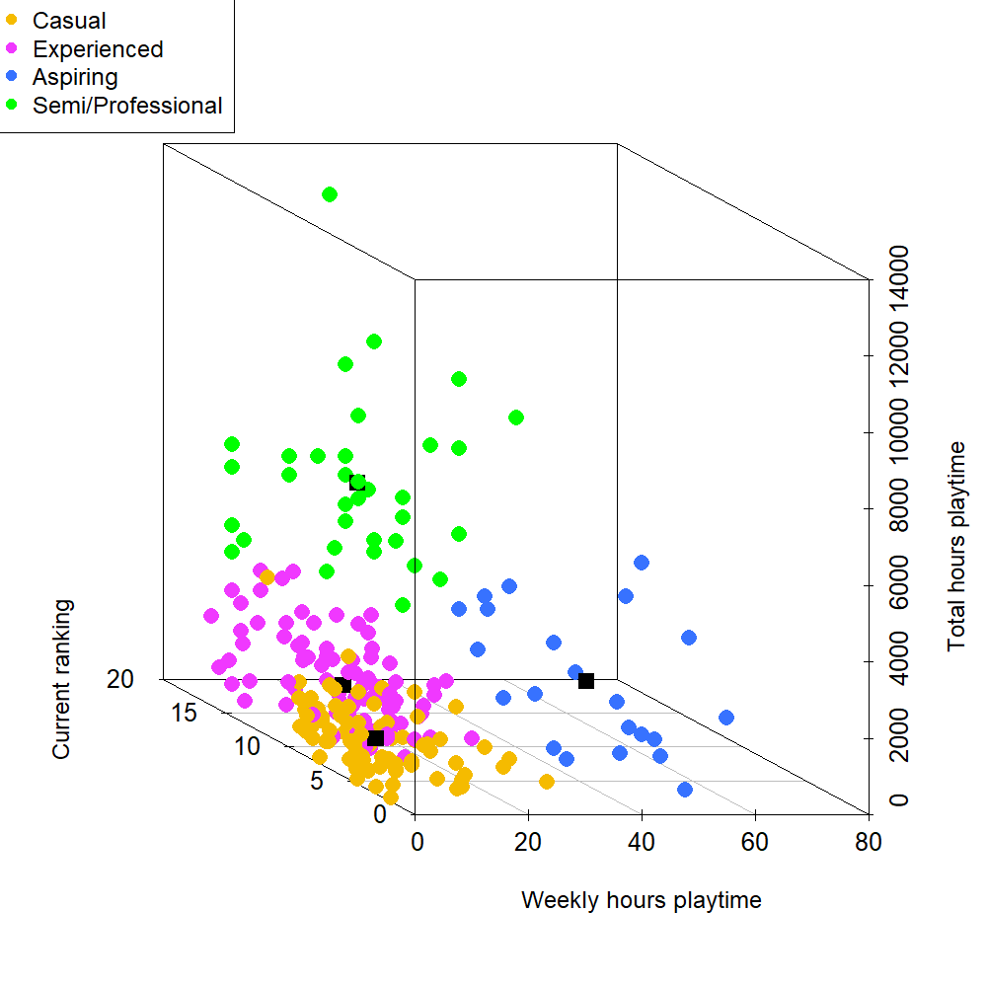
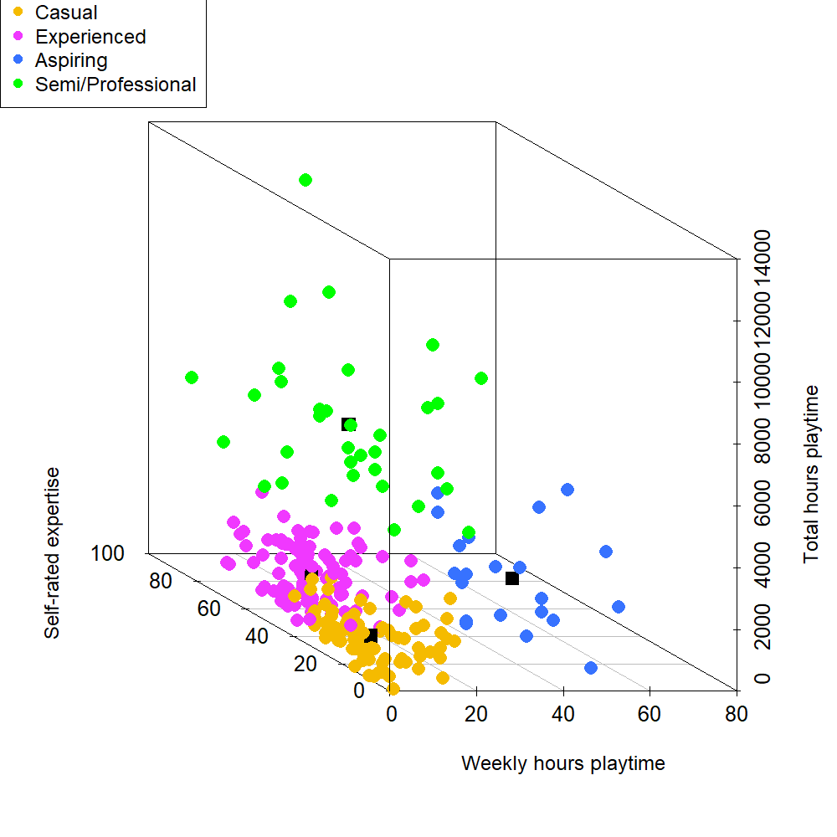
K-means cluster analysis N = 235
Semi/Professional
Aspiring
Experienced
Casual
scatterplot3d function from the scatterplot3d package in R
Notes:
Unsupervised machine learning algorithm which groups observations into k cluster groups with minimum within-cluster variation.
4 Expertise Cluster Groups
3d scatter plot with our variables on the following axis
Weekly hours on the x and total hours on the y, with current ranking on the z in the left plot and self-rated expertise on the z in the right plot
Displays the range of expertise in our participants and a story of perhaps how we travel through these expertise groups
Clustering gives us an amazing overview of the expertise of our sample – in greater depth than would have been possible with one measure of video game expertise

Slide 13
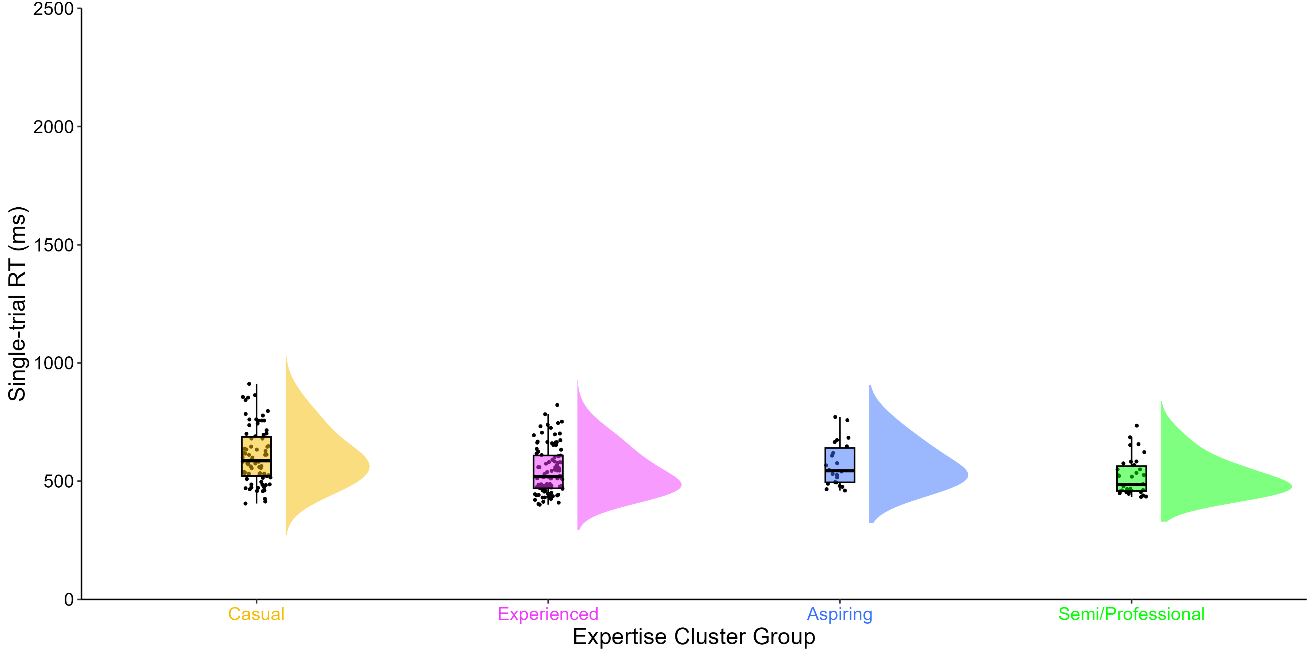
Processing Speed – Single rule block
M = 607.64
SD = 118.60
M = 544.76
SD = 99.13
M = 572.44
SD = 93.53
M = 519.12
SD = 79.20
Single-trial RT x Group: BF = 508
raincloudplots and PupillometryR packages in R
M = 591, SD = 112
Notes:
Cognitive dependent variables starting with RTs
Raincloud plot: X = RTs, Y = groups
Dots = participant
Box plot = summarises data from each group in terms of the maximum, minimum, interquartile range and median
Cloud = distribution (normal distribution in the shape of a bell (semi/pro), but can be more skewed (casual)
Single RTs - 90ms difference between slowest casuals and fastest semi/professionals
Bayes Factor in favour of strong evidence for an effect of expertise cluster groups on single RTs

Slide 14
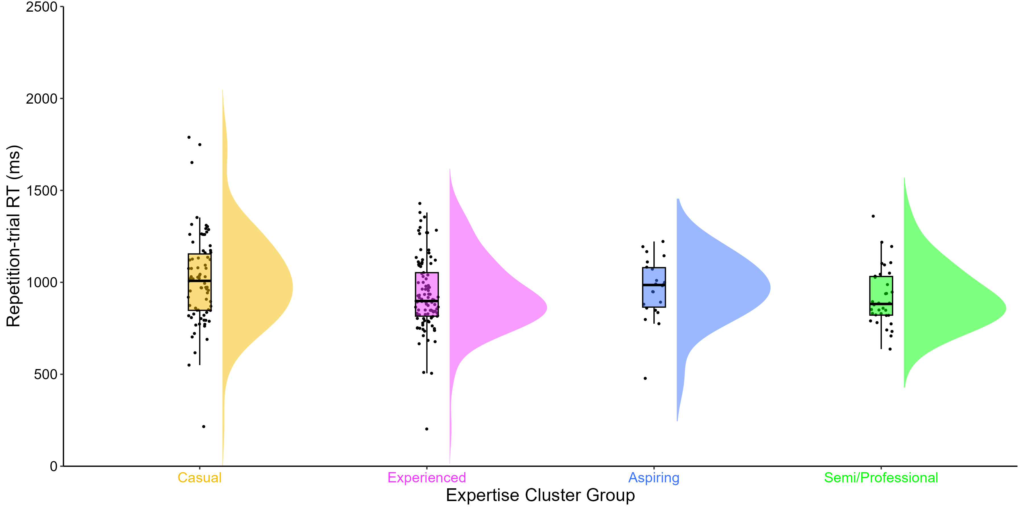
Processing Speed – Mixed rule block
M = 1013.01
SD = 249.45
M = 931.97
SD = 198.46
M = 964.89
SD = 168.83
M = 920.15
SD = 159.25
M = 1213.20
SD = 295.47
M = 1067.60
SD = 238.71
M = 1170.66
SD = 236.54
M = 1147.87
SD = 203.57
Repetition-trial RT x Group: BF = 1/1
Switch-trial RT x Group: BF = 17
raincloudplots and PupillometryR packages in R
M = 591, SD = 112
Notes:
Repetition RTs - 90ms difference between slowest casuals and fastest semi/professionals
No Bayes Factor evidence for an effect of expertise cluster groups on repetition RTs
Switch RTs – 60ms difference between slowest casuals and semi/professionals, but experienced players showed the fastest RTs on switch trials
Bayes Factor in favour of some evidence for an effect of expertise cluster groups on switching costs.

Slide 15
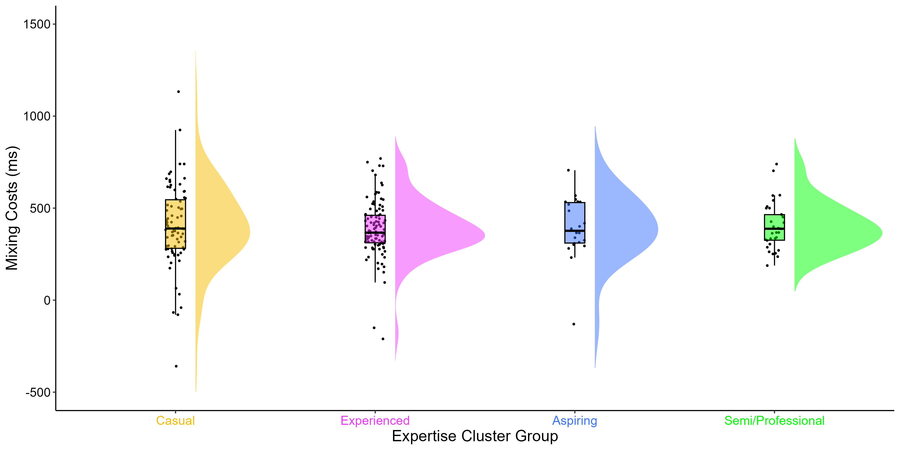
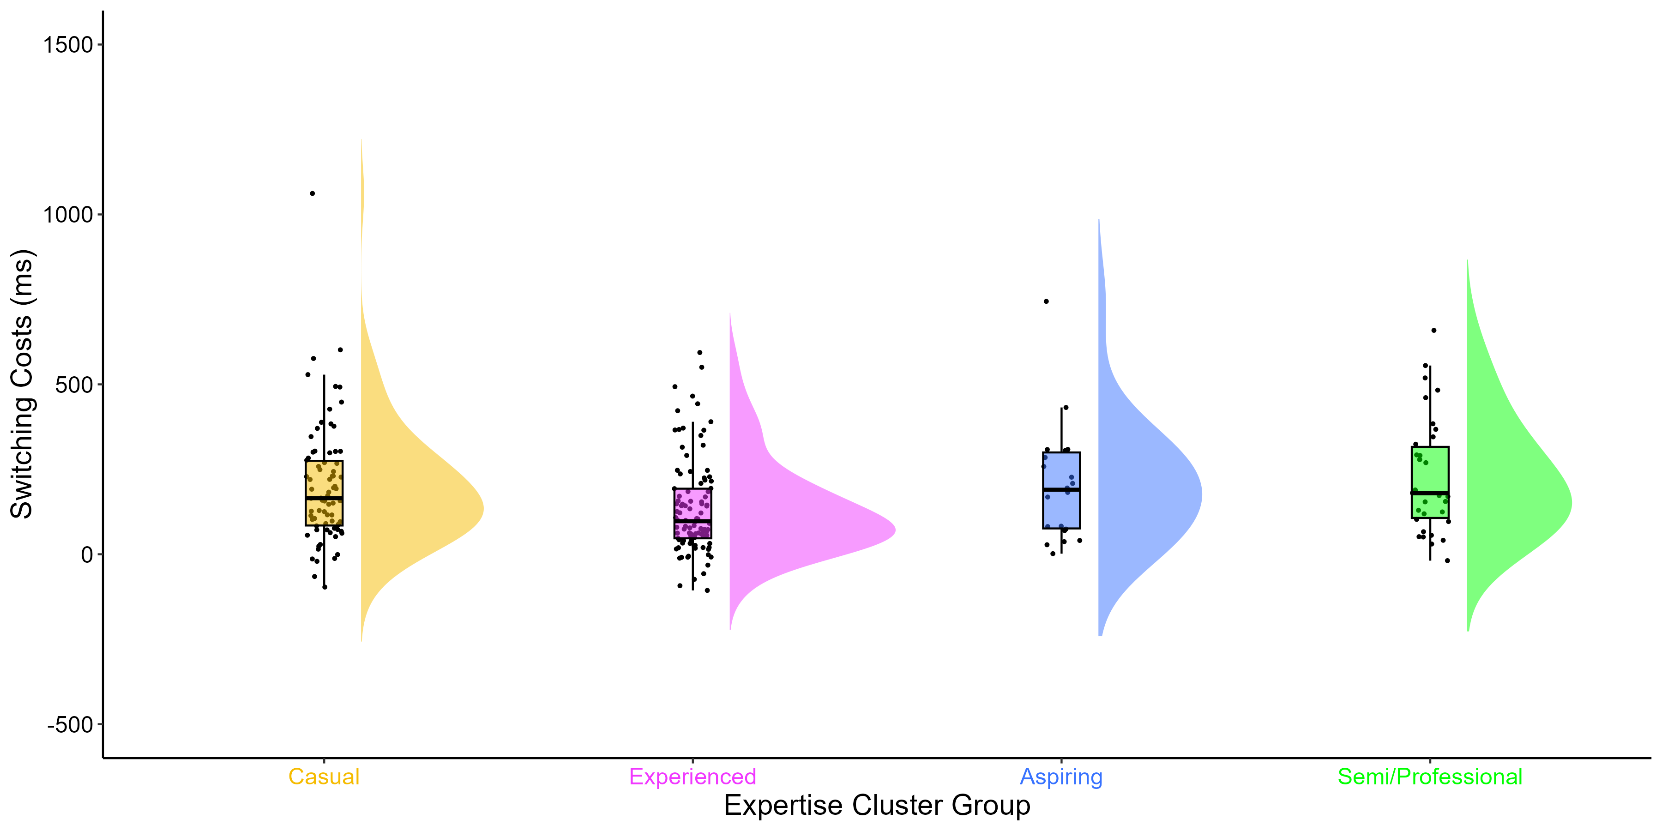
Multitasking – Mixed rule block
M = 405.37
SD = 223.18
M = 387.21
SD = 156.32
M = 392.45
SD = 167.72
M = 401.02
SD = 126.41
M = 200.19
SD = 177.58
M = 135.64
SD = 139.59
M = 205.77
SD = 167.50
M = 227.72
SD = 167.16
Mixing Costs x Group: BF = 1/30
Switching Costs x Group: BF = 6.6
Notes:
Mixing costs performance cost to mix two different tasks – calculated as the difference between RT performance on repetition trials from the mixed block, and RT performance on single trials in the single block.
All have pretty similar mixing costs – similar ability across groups to mix tasks.
Switching Costs performance cost to switch between two sequentially presented tasks – calculated as the difference between RT performance on switch trials and repetition trials in the mixed block.
For switching costs, a difference of about 30ms between our casual and professional players and the directionality of this is interesting because our more experienced players actually show greater switching costs, indicating that they struggled to switch between tasks more so than our less expert players.
Bayes Factor in favour of some evidence for an effect of expertise cluster groups on switching costs.
So, our more expert players showed greater switching costs, in that the transition from the previous trial affected the response of the current trial. Whilst our less expert players, particularly our experienced players, were impacted less by task switching.

Slide 16


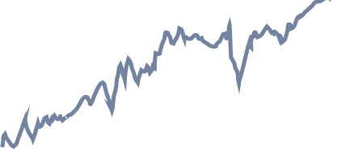
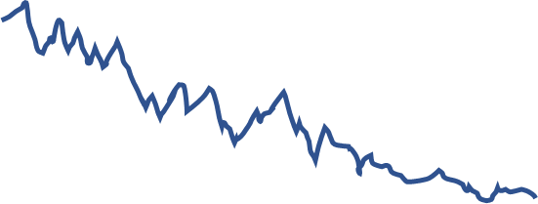

Drift diffusion modelling
No differences in accuracy, but Semi/Professionals have the fastest RTs.
Different
Non-decision time
Drift rate
Boundary
separation
Same
Fast-DM with a free parameter model in R
Notes:
We found no differences in accuracy between our expertise groups, but we found highly expert CS players had faster RTs than less expert players
Suggesting that CS expertise is associated with faster processing speed performance, with no sacrifices in accuracy
To investigate this further, we used a Drift-Diffusion model (previously been described)
Drift rate = rate of information accumulation – how fast you are when gathering information during the task
Boundary separation = response caution – how careful you are when making your response during the task
Non-decision time = encoding and response execution – encoding is your first experience in perceiving and learning information from the task, response execution is literally the rate at which you hit the button for green/blue
These 3 measures give us a lot more detailed information about the processing speed of our players

Slide 17
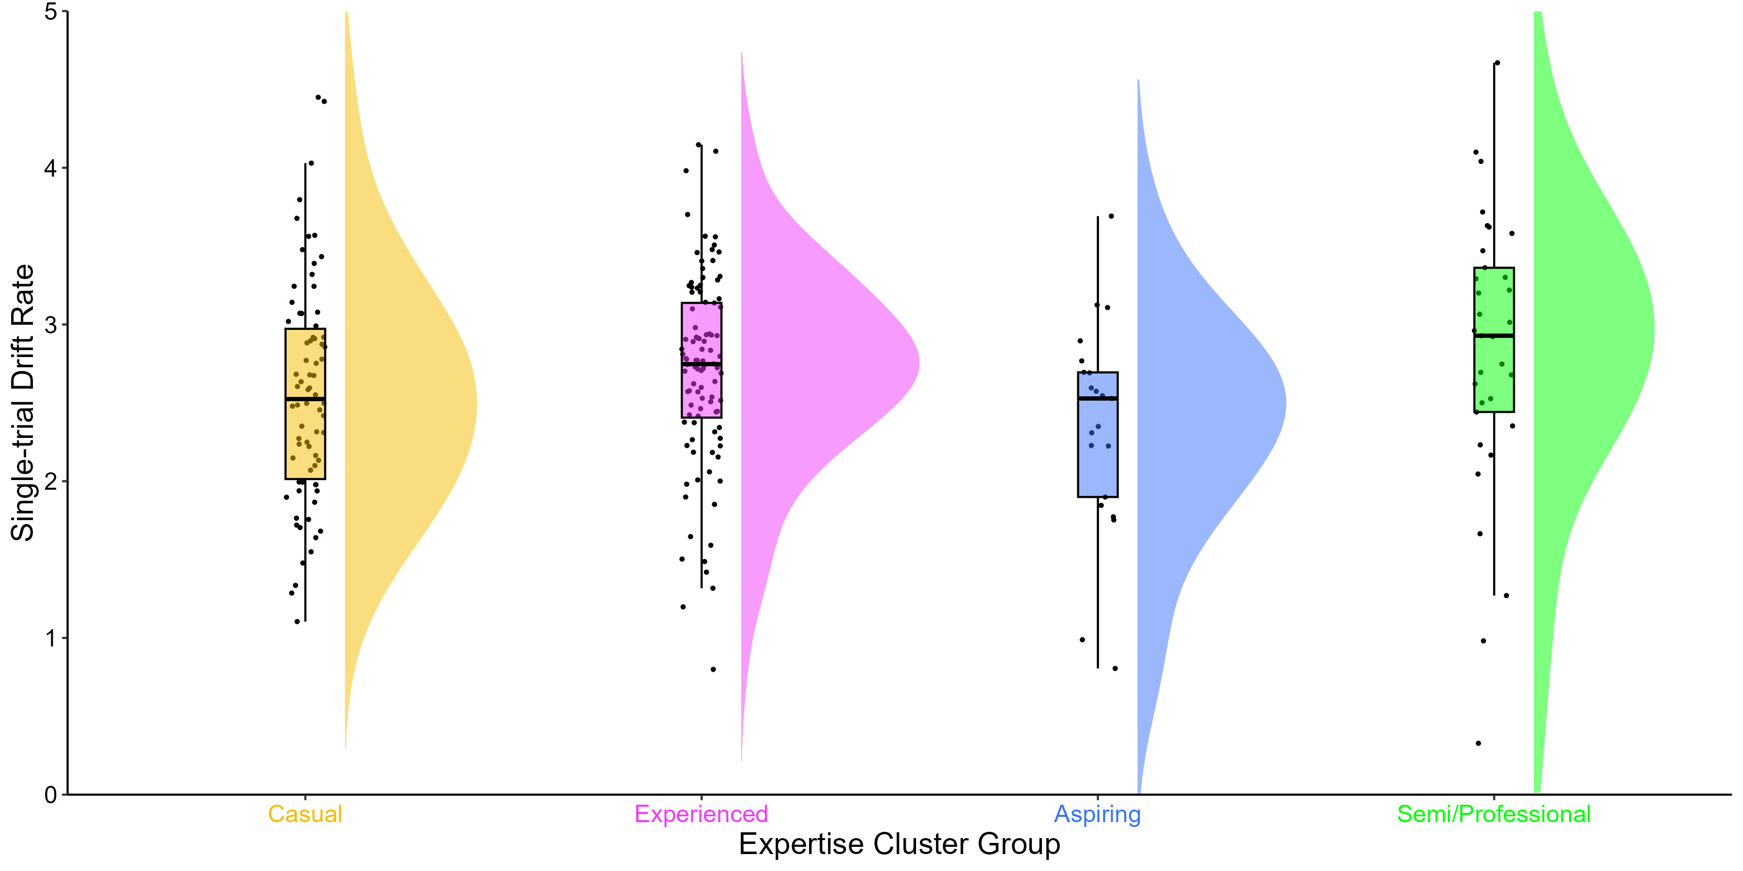
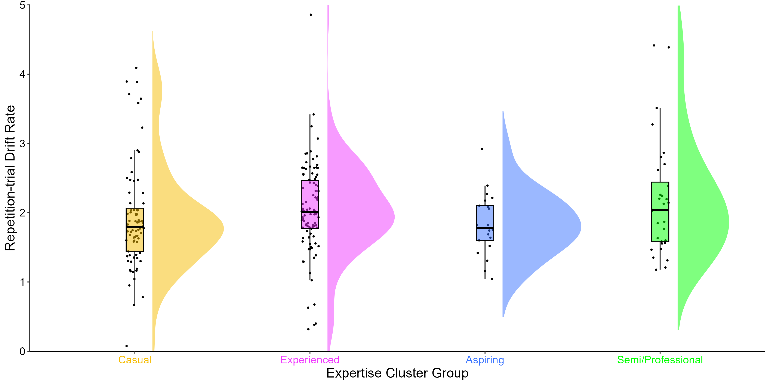
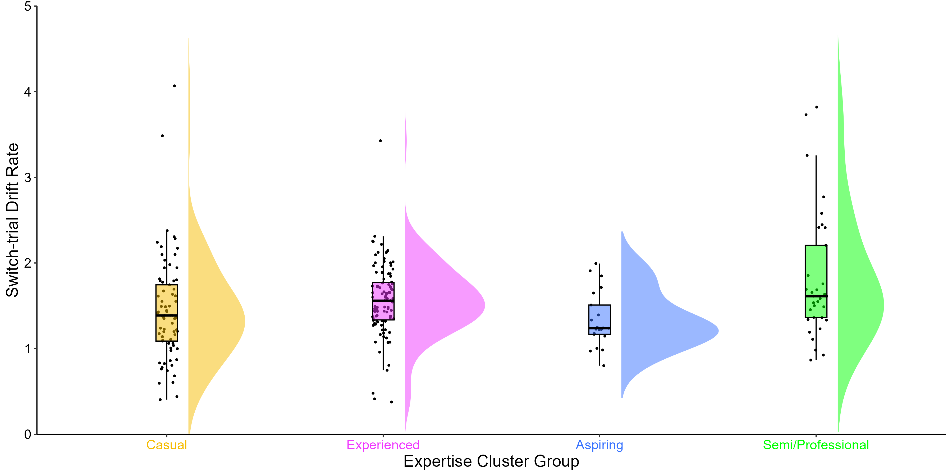
Drift Rates
M = 2.66
SD = 0.91
M = 2.69
SD = 0.63
M = 2.35
SD = 0.66
M = 2.91
SD = 1.01
M = 1.97
SD = 0.88
M = 2.13
SD = 0.91
M = 1.84
SD = 0.43
M = 2.36
SD = 1.08
M = 1.44
SD = 0.60
M = 1.58
SD = 0.59
M = 1.35
SD = 0.33
M = 1.83
SD = 0.74
Single-trial Drift Rate x Group: BF = 1/3
Repetition-trial Drift Rate x Group: BF = 1/3
Switch-trial Drift Rate x Group: BF = 3.7
M = 591, SD = 112
Notes:
Drift rate = rate of information accumulation – how fast you are when gathering information during the task
Single-trials: expert Semi/Pro players showed faster information accumulation, in terms of higher drift rates.
Bayes Factor showed no evidence for an effect of expertise cluster groups (perhaps due to noisy data in our semi/professional players – cloud/distribution is very flat and wide compared to other groups)
Repetition-trials and Switch-trials: drift rates also higher for more expert players in the mixed block.
Bayes Factor in favour of some evidence for an effect of expertise cluster groups on drift rates in Switch trials.

Slide 18
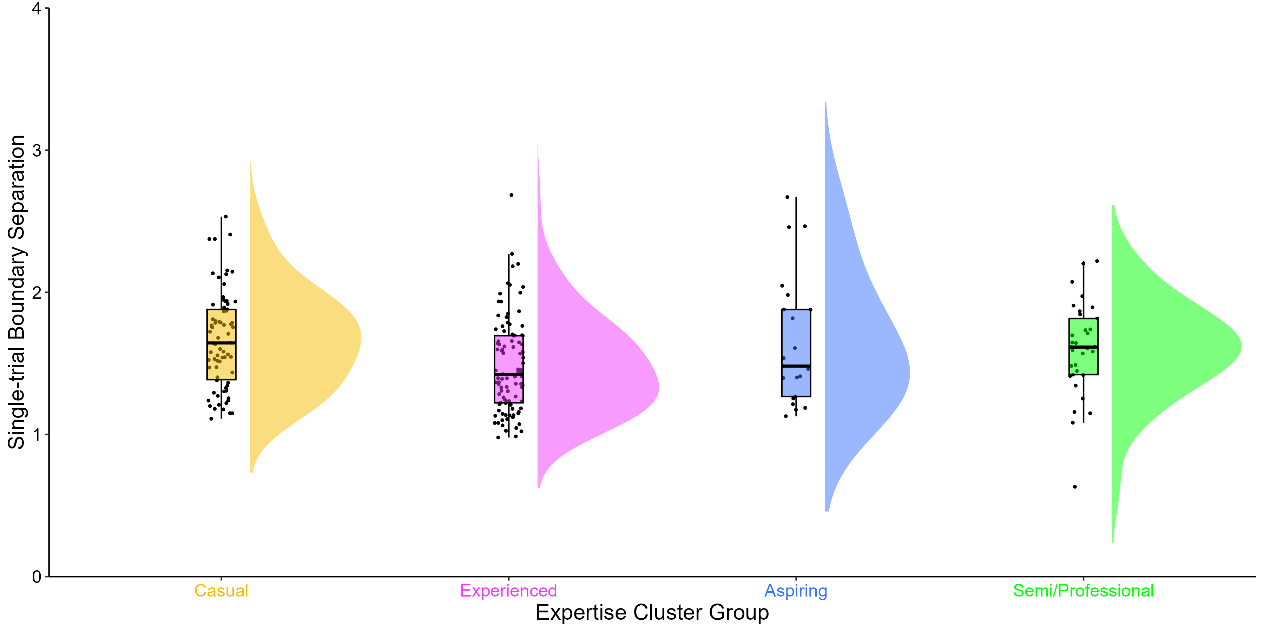
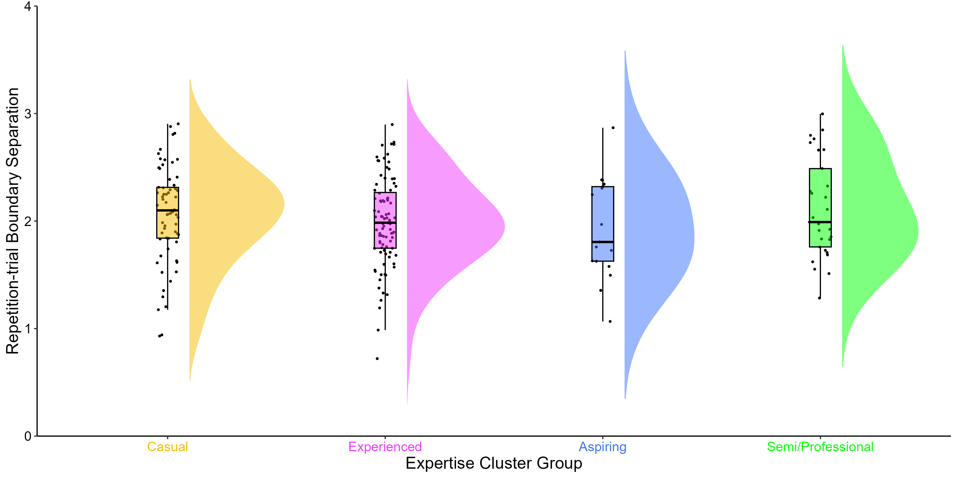
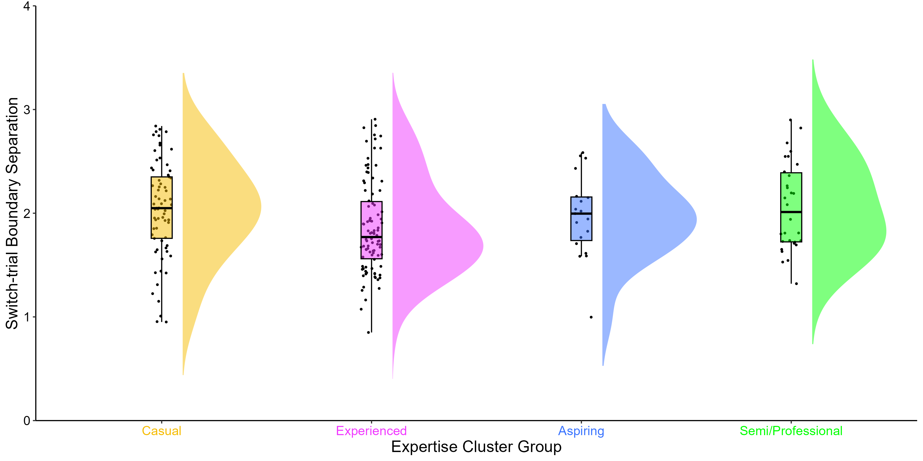
Boundary Separation
M = 1.75
SD = 0.56
M = 1.48
SD = 0.33
M = 1.65
SD = 0.45
M = 1.80
SD = 1.19
M = 2.53
SD = 1.39
M = 2.27
SD = 1.27
M = 2.29
SD = 0.81
M = 2.74
SD = 1.83
M = 2.32
SD = 1.22
M = 2.04
SD = 1.01
M = 2.11
SD = 0.53
M = 2.40
SD = 1.91
Single-trial Boundary Separation x Group: BF = 3.7
Repetition-trial Boundary Separation x Group: BF = 1/8
Switch-trial Boundary Separation x Group: BF = 1/5
M = 591, SD = 112
Notes:
Boundary separation = response caution – how careful you are when making your response during the task
Experienced players had the lowest boundary separations and were therefore less cautious in their decision making.
Only have a Bayes factor in favour of some evidence for an effect of expertise cluster groups on single-trial boundary separation.

Slide 19
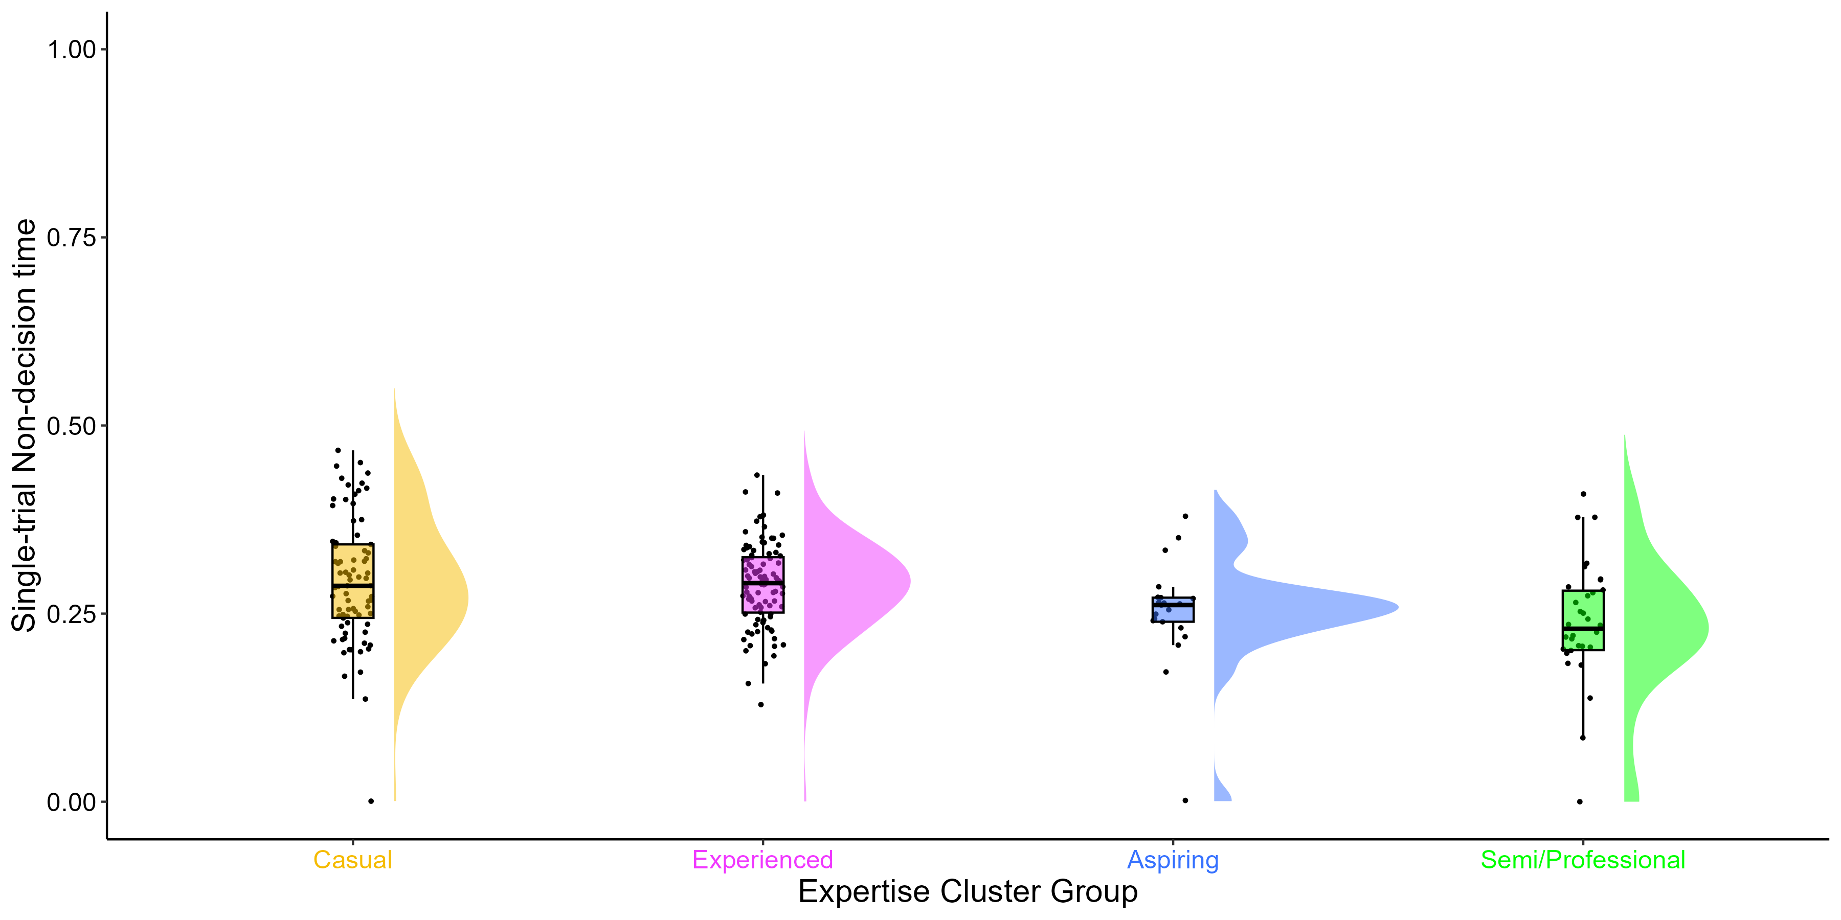
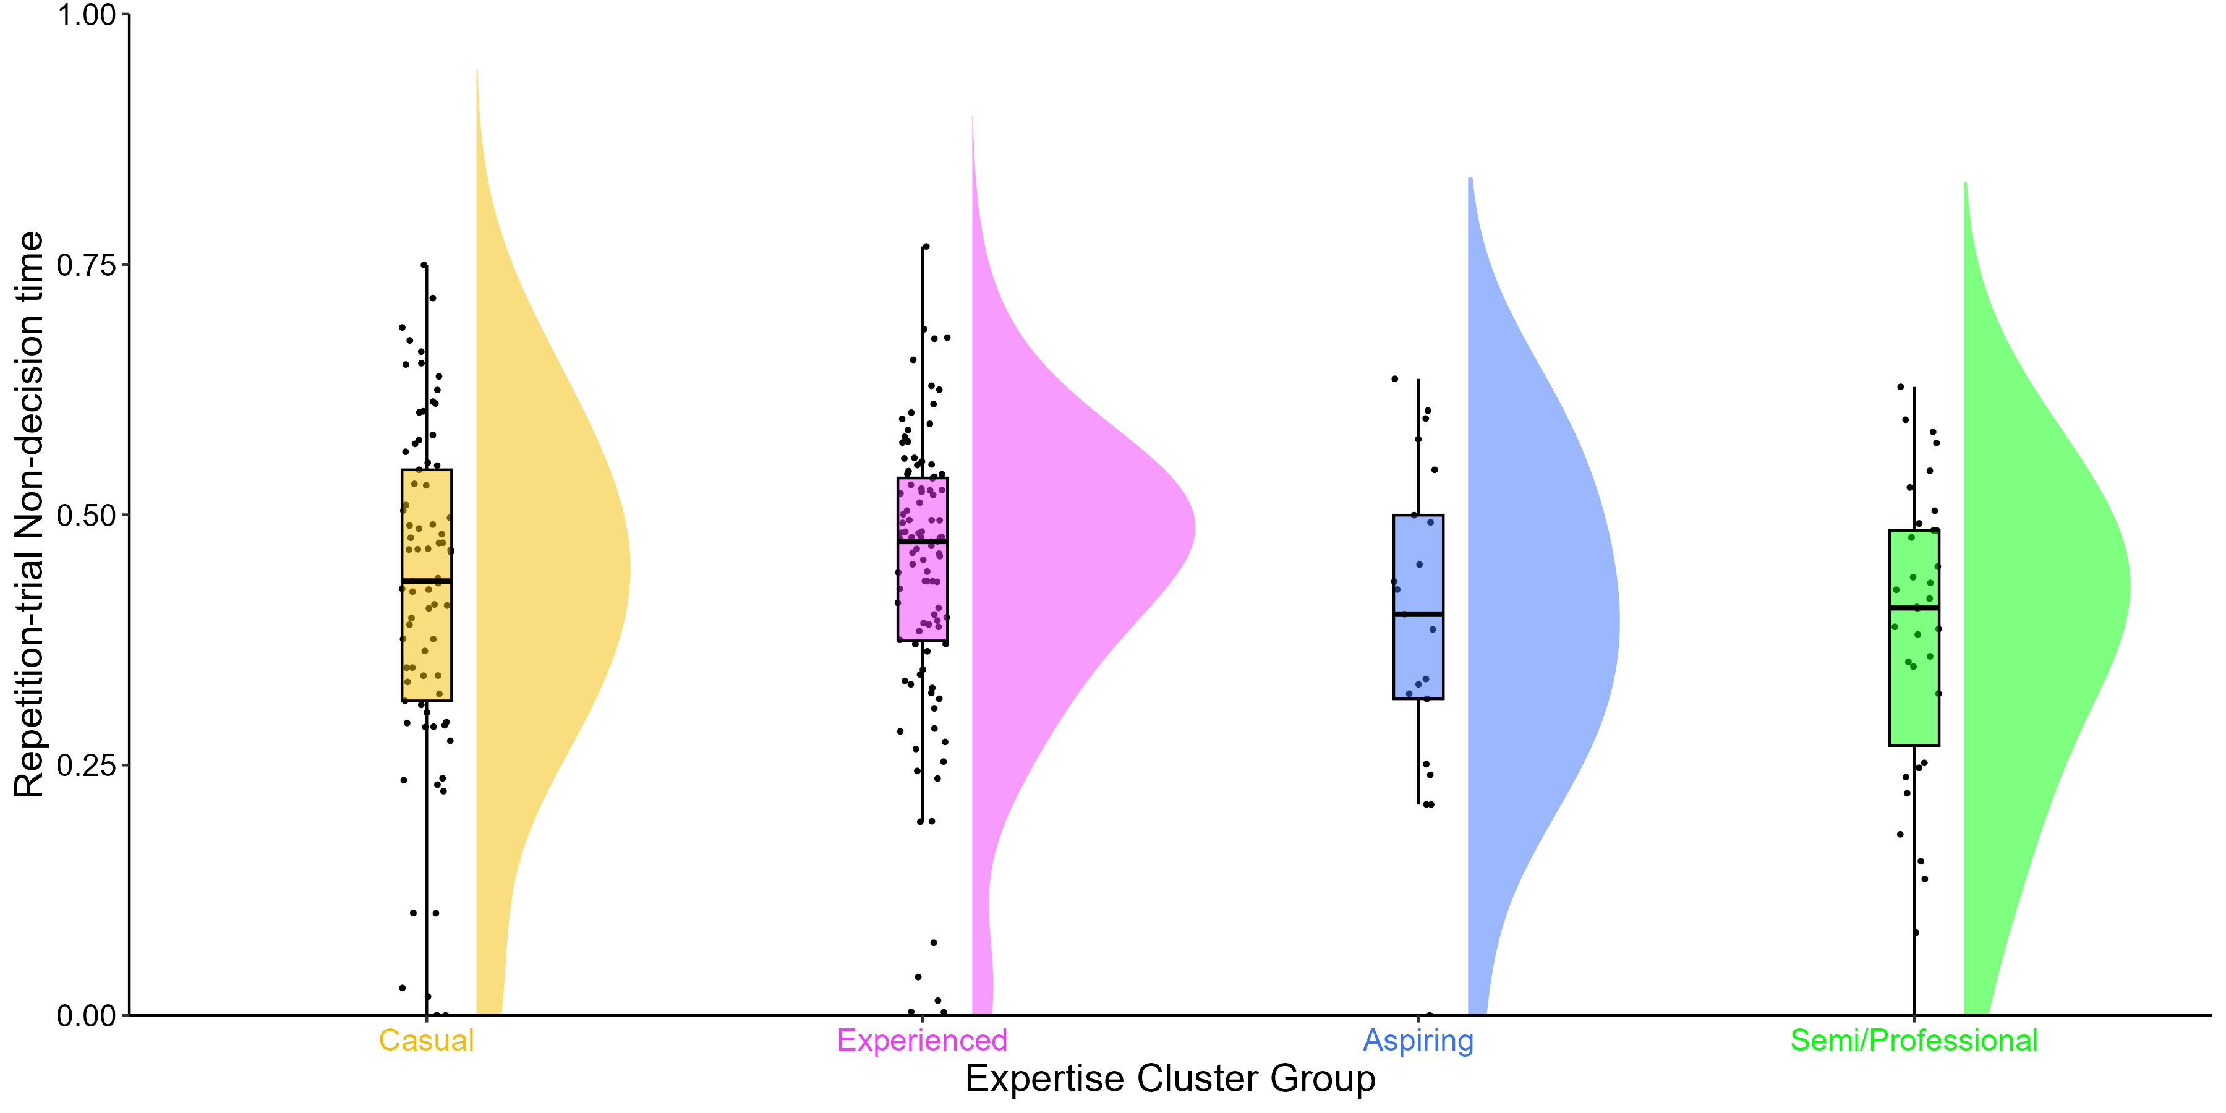
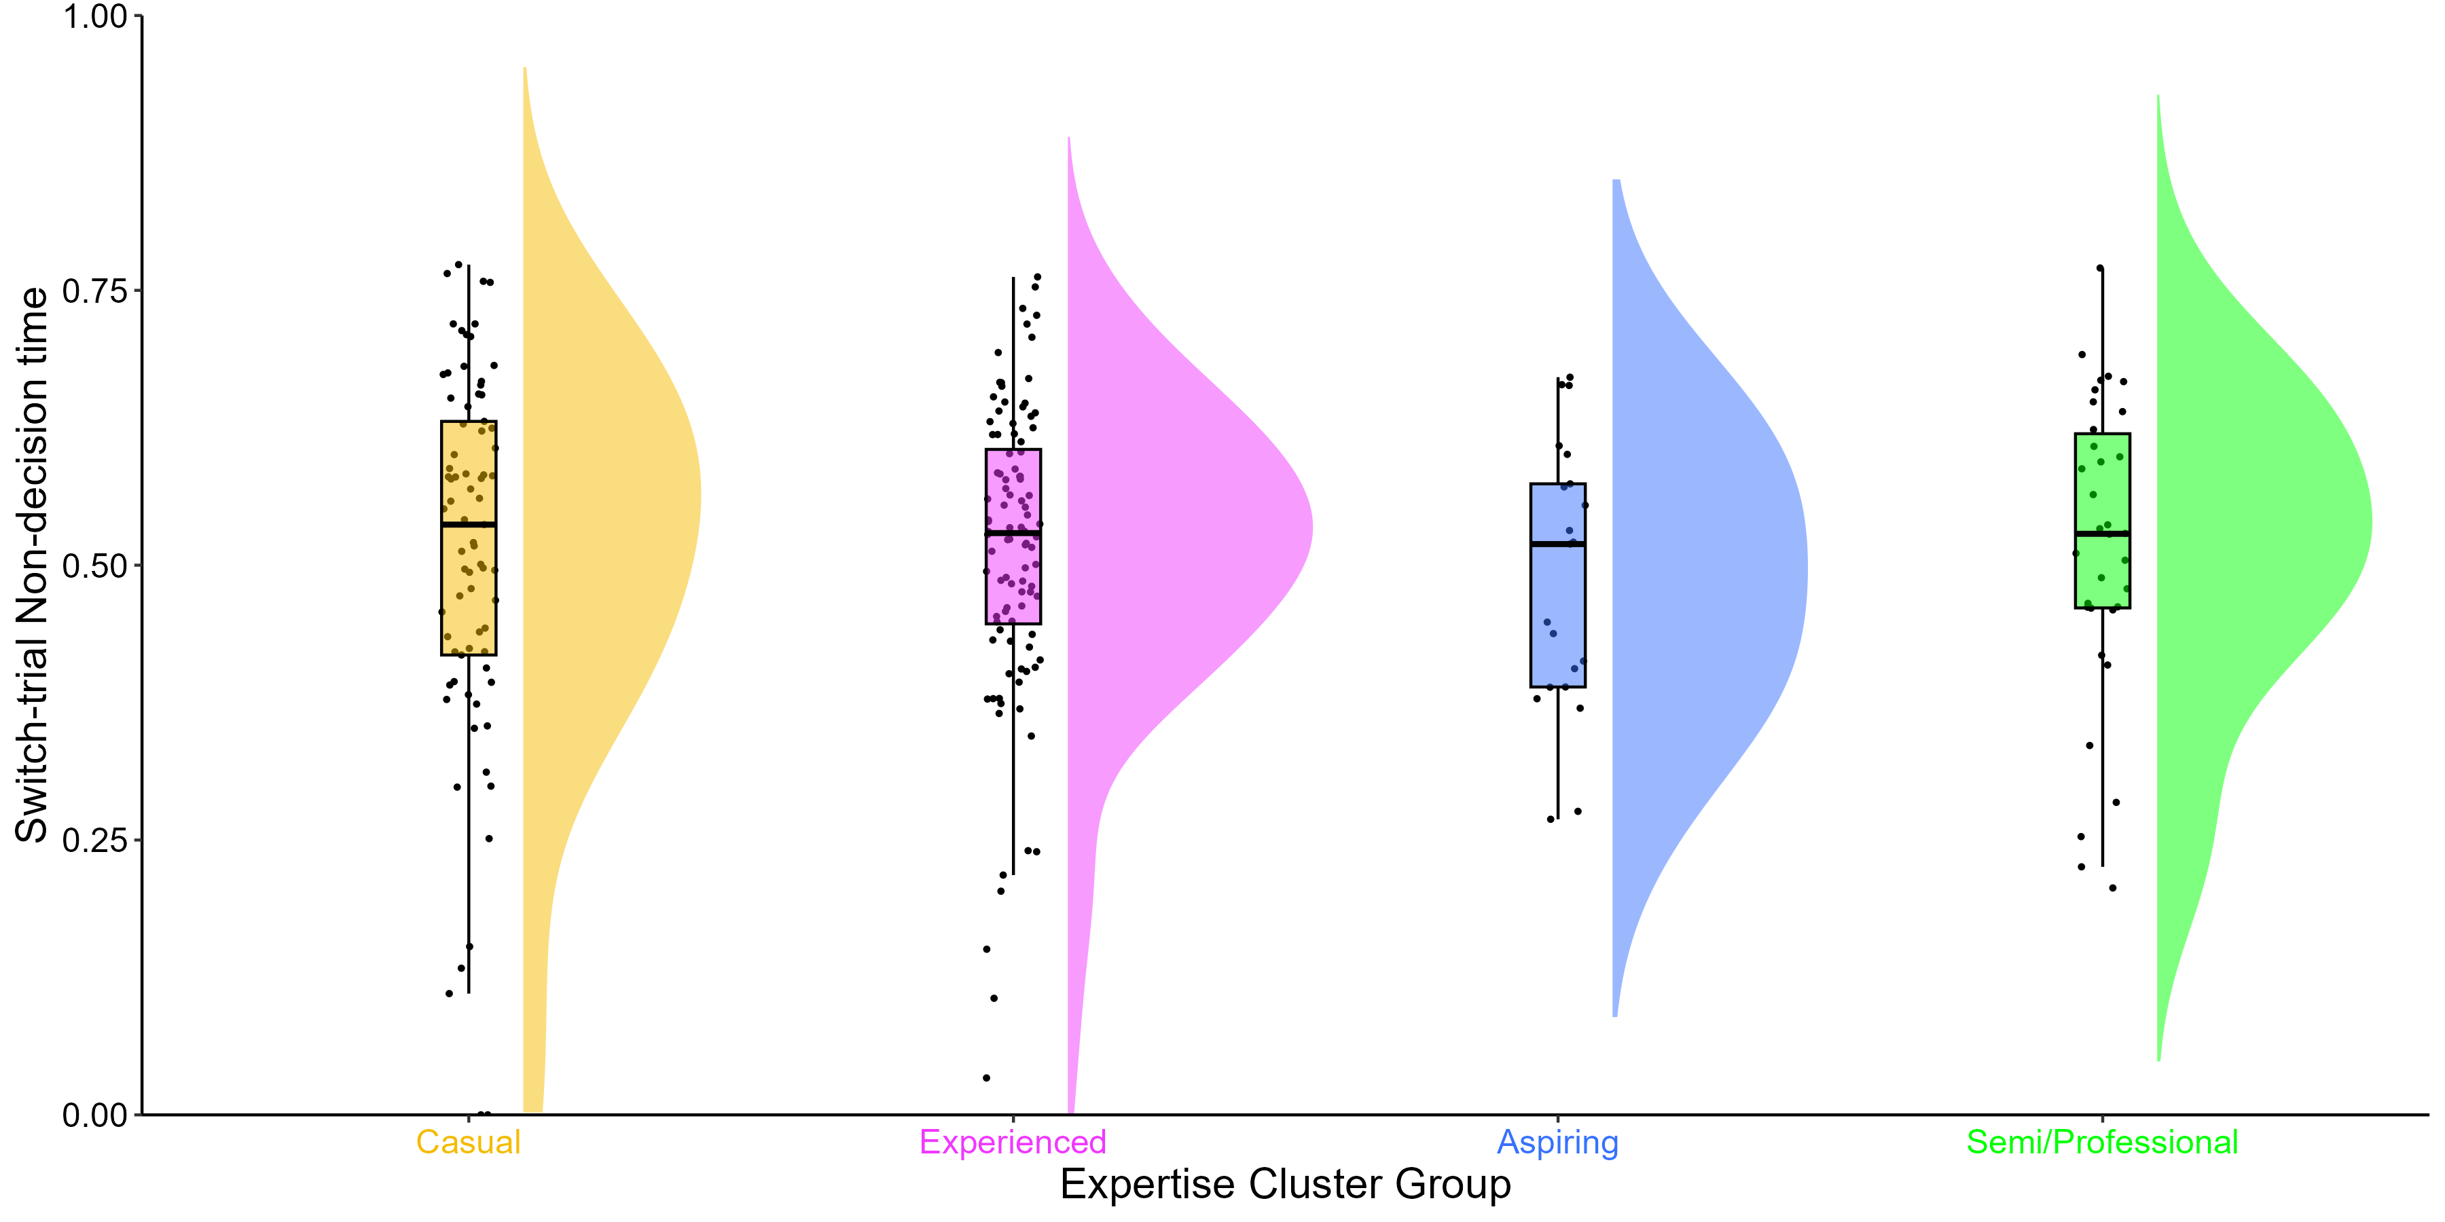
Non-decision Time
M = 0.29
SD = 0.08
M = 0.28
SD = 0.07
M = 0.25
SD = 0.07
M = 0.23
SD = 0.10
M = 0.42
SD = 0.17
M = 0.44
SD = 0.15
M = 0.39
SD = 0.16
M = 0.38
SD = 0.15
Single-trial Non-decision time x Group: BF = 280
M = 0.51
SD = 0.18
M = 0.51
SD = 0.14
M = 0.49
SD = 0.12
M = 0.52
SD = 0.14
Repetition-trial Non-decision time x Group: BF = 1/5
Switch-trial Non-decision time x Group: BF = 1/30
M = 591, SD = 112
Notes:
Non-decision time = encoding and response execution
Encoding initial perception of information
Response execution is literally the rate at which you hit the button for green/blue.
Semi/Pro players had the shorted non-decision times, our more expert CS players perceive information and execute their responses faster than less expert players.
Only have a Bayes factor in favour of strong evidence for an effect of expertise cluster groups on single-trial non-decision time.

Slide 20
Summary
CS expertise is a multi-dimensional construct that a range of measures can capture.
Highly expert CS players show advantages in processing speed.
Drift diffusion modelling demonstrates advantages non-decision times.
Faster RTs with no impact on accuracy scores
K means clustering is one method, same in other samples, with other measures?
Faster in their perception of and response to stimuli.

Slide 21



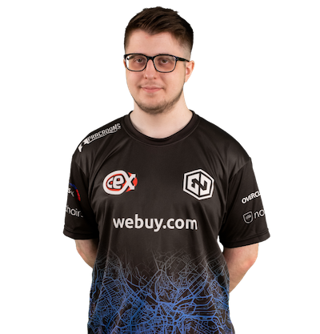

Take Home Message
Advantages in cognition appear to show transfer from a highly complex video game to that of a simple cognitive task – perhaps skills gained in video games are present in everyday life.
Include expert players in the development of your research!
Notes:
If true, than it may be that video games can be used to train specific cognitions in people who would benefit from improvement in those cognitions such as in the elderly who show reduced processing speeds, the possibilities are endless.
When developing video game research proposals, involve people who know the most about those games so that you can best develop measures – Professional CS players at Endpoint, Sheffield based eSports organisation.

Slide 22



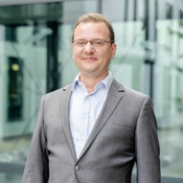


Thanks for listening!
erahyde1@sheffield.ac.uk
www.eleanorhyde.com
Dr Claudia von Bastian
The University of Sheffield
Dr Robert Schmidt
Ruhr-Universität Bochum
Dr Dan Carroll
The University of Sheffield
Endpoint

Slide 23
Processing Speed
Casual
Experienced
Aspiring
Semi/Professional
Single-trial RT x Group: BF = 508
Repetition-trial RT x Group: BF = 1/1
Switch-trial RT x Group: BF = 17
Notes:
Single RTs -90ms difference between slowest casuals and fastest semi/professionals
Repetition RTs - 90ms difference between slowest casuals and fastest semi/professionals
Switch RTs – 60ms difference between slowest casuals and semi/professionals, but experienced players showed the fastest RTs on switch trials
Bayes Factor in favour of some evidence for an effect of expertise cluster groups on switching costs.
Bayes Factor in favour of strong evidence for an effect of expertise cluster groups on single RTs switch and moderate evidence for switch RTs.
Also found no differences in accuracy, suggesting that CS expertise is associated with faster processing speed performance, with no sacrifices in accuracy.
Lets look at their multitasking

Slide 24
Accuracy Score
Casual
Experienced
Aspiring
Semi/Professional
Single-trial Score x Group: BF = 1/12
Repetition-trial Score x Group: BF = 1/19
Switch-trial Score x Group: BF = 1/2
Notes:
No differences in accuracy

Slide 25
Multitasking
Casual
Experienced
Aspiring
Semi/Professional
Mixing Costs x Group: BF = 1/30
Switching Costs x Group: BF = 6.6
Notes:
Mixing costs performance cost to mix two different tasks – calculated as the difference between RT performance on repetition trials from the mixed block, and RT performance on single trials in the single block.
All have pretty similar mixing costs – similar ability across groups to mix tasks.
Switching Costs performance cost to switch between two sequentially presented tasks – calculated as the difference between RT performance on switch trials and repetition trials in the mixed block.
For switching costs, a difference of about 30ms between our casual and professional players and the directionality of this is interesting because our more experienced players actually show greater switching costs, indicating that they struggled to switch between tasks more so than our less expert players.
Bayes Factor in favour of some evidence for an effect of expertise cluster groups on switching costs.

Slide 26
Drift Rates
Casual
Experienced
Aspiring
Semi/Professional
Single-trial Drift Rate x Group: BF = 1/3
Repetition-trial Drift Rate x Group: BF = 1/3
Switch-trial Drift Rate x Group: BF = 3.7
Notes:
Fab overview of drift-diffusion modelling earlier today from Alice
Drift rate = rate of information accumulation
More expert Semi/Pro players did show faster information accumulation across all trial types.
Only have a Bayes factor in favour of some evidence for an effect of expertise cluster groups on switch-trial drift rates.

Slide 27
Boundary Separation
Casual
Experienced
Aspiring
Semi/Professional
Single-trial Boundary Separation x Group: BF = 3.7
Repetition-trial Boundary Separation x Group: BF = 1/8
Switch-trial Boundary Separation x Group: BF = 1/5
Notes:
Boundary separation = response caution – how careful you are when making your response during the task
Experienced players had the lowest boundary separations and were therefore less cautious in their decision making.
Only have a Bayes factor in favour of some evidence for an effect of expertise cluster groups on single-trial boundary separation.

Slide 28
Non-Decision Time
Casual
Experienced
Aspiring
Semi/Professional
Single-trial Non-decision time x Group: BF = 280
Repetition-trial Non-decision time x Group: BF = 1/5
Switch-trial Non-decision time x Group: BF = 1/30
Notes:
Non-decision time = encoding and response execution
Encoding initial perception of information
Response execution is literally the rate at which you hit the button for green/blue.
Semi/Pro players had the shorted non-decision times, our more expert CS players perceive information and execute their responses faster than less expert players.
Only have a Bayes factor in favour of strong evidence for an effect of expertise cluster groups on single-trial non-decision time.

